Slide 1


Dept. of CS&E ( DATA SCIENCE)
Adichunchanagiri Institute of Technology Chikkamagaluru - 577102
Mini Project – Presentation on
‘‘AI-Driven hospital queue and bed availability tracking system’’
Presented By,
Group-09
Ganesh H (4AI23CD018)
Manasa Y K (4AI23CD027)
Megha G K (4AI23CD028)
Nilesh Kumar Jha (4AI23CD032)
Under the Guidance Of,
Asst Prof. Gagana Deepa J
Dept of Data Science AIT,CKM

Slide 2
AGENDA
Problem Statement
Scope of the Project
Project Design
Methodology
Implementation
Challenges Faced
Results
Future Work
Conclusion
GitHub Link

Slide 3
Problem Statement
To design an AI-driven web app that addresses the issues like long queues, overcrowded waiting areas, and poor patient flow due to absence of a unified and real-time system. The lack of instant updates on bed and appointment availability leads to delays, miscommunication, and operational inefficiency. This system streamline the patient movement, improve transparency, and optimize hospital resource management.

Slide 4
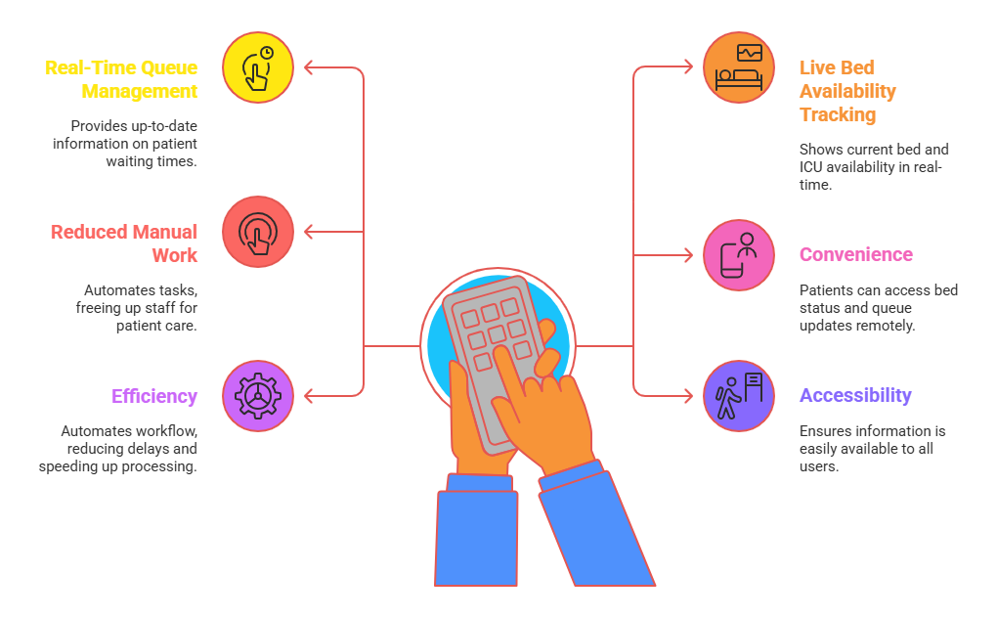
Scope of the Project
Key Areas Covered
Hospital search based on name/location.
Real-time bed availability checking.
Online token booking system.
Real-time queue position tracking through AI-powered chatbot.
Expected Impact
Reduces patient waiting time.
Provides transparency in queue management.
Improves hospital workflow and user experience.
Fig 1: Scope of project

Slide 5
Project Design
Components Involved
Frontend: User portal, admin dashboard, chatbot UI.
Backend: Queue processing, token generation, bed management.
Database: Stores hospital, queue, token, and bed data.
AI Component: Chatbot for answering patient queries.
System design
Login : User signs in to the system.
Search Hospital : User searches the hospital they want to visit.
Token : books a token for same day consultation and adds user to the live queue.
Track With AI Bot : AI bot shows queue position, updates, and waiting time.
Bed Availability : User can check free and occupied beds and hold a bed in emergency cases.
Book Scheduled Appointment : User can select a doctor and book a future appointment.

Slide 6
Methodology
Steps Followed
Requirement analysis and planning.
Designing UI/UX for the system.
Building backend logic for queue and token management.
Implementing hospital search and bed availability module.
Integrating AI chatbot for real-time updates.
Testing , debugging and deployment.
Tools & Technologies
Frontend: HTML, CSS
Backend: Python ( Django)
Database: SQlite
AI component : Gemini API, Tensor flow

Slide 7
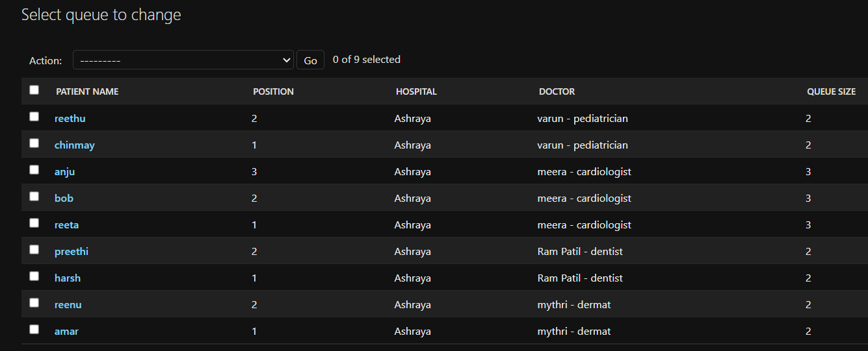
Implementation
Token generation logic based on hospital and department.
Queue table updates in real time.
Added real-time queue and bed updates using API calls.
Used a database to store queue and bed details.
Implemented validation to avoid duplicate entries.
Synced admin updates instantly with chatbot responses.
Fig 2:Real time queue table

Slide 8
Challenges Faced
Designing a smooth and responsive UI for both patient and admin use.
Implementing real-time queue updates without delays.
Managing synchronization between admin updates and chatbot responses.
Preventing duplicate entries during queue join/leave.
How Challenges Were Solved
Added efficient API calls for instant updates.
Optimized database queries.
Added unique token IDs for each patient using timestamp + user ID.

Slide 9
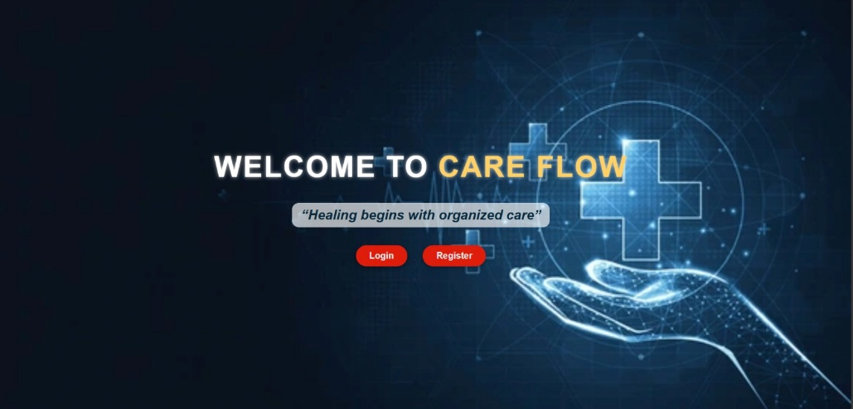
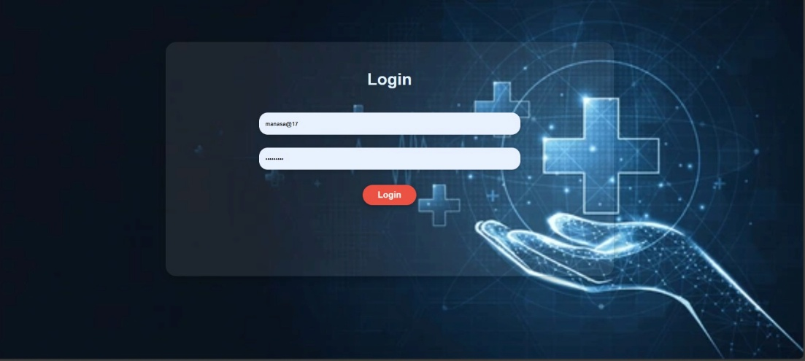
Results
Fig 3: Landing Page
Fig 4 : Login Page

Slide 10
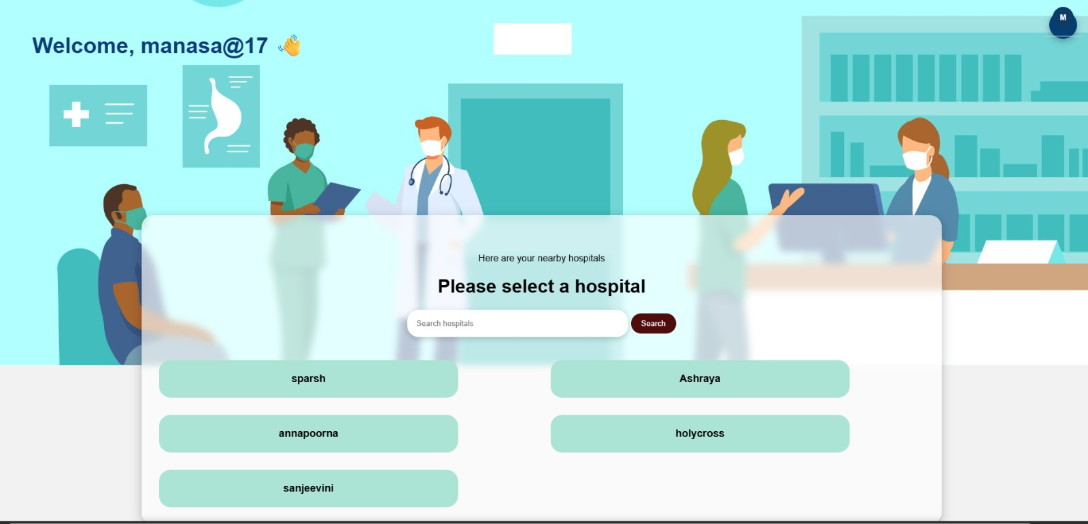
Results
Fig 5 : Home Page

Slide 11
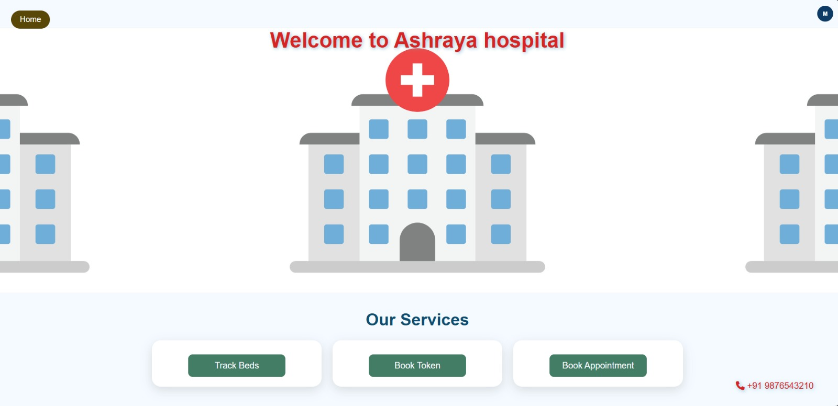
Results
Fig 6 : Selected Hospital

Slide 12
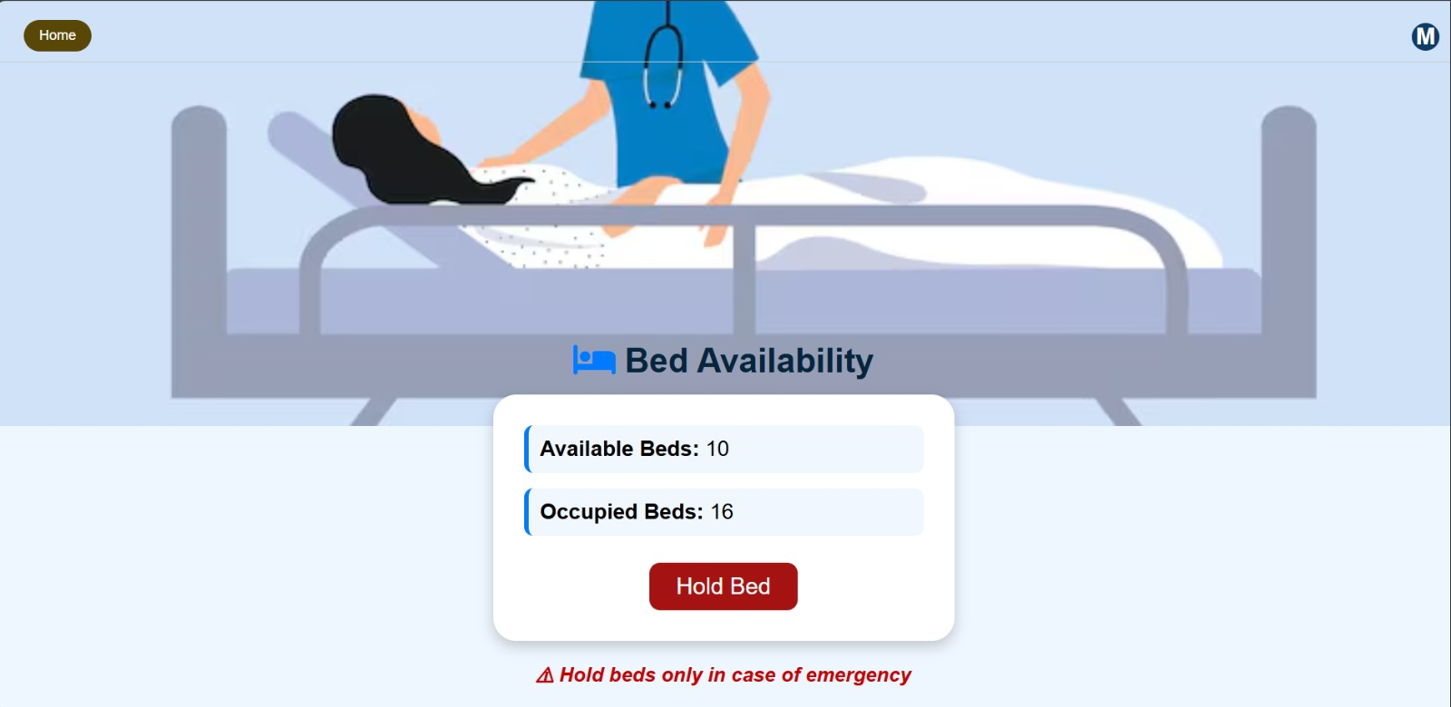
Results
Fig 7 : Bed availability

Slide 13
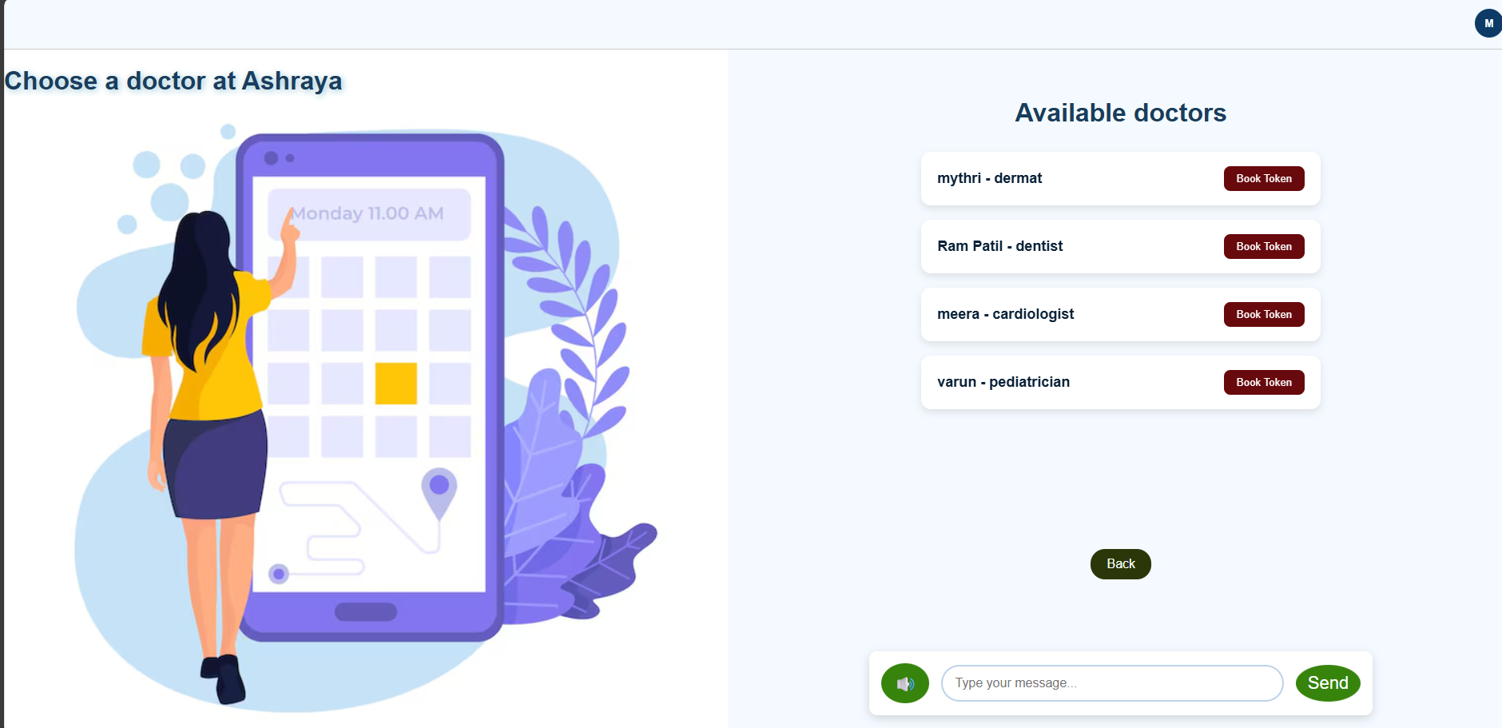
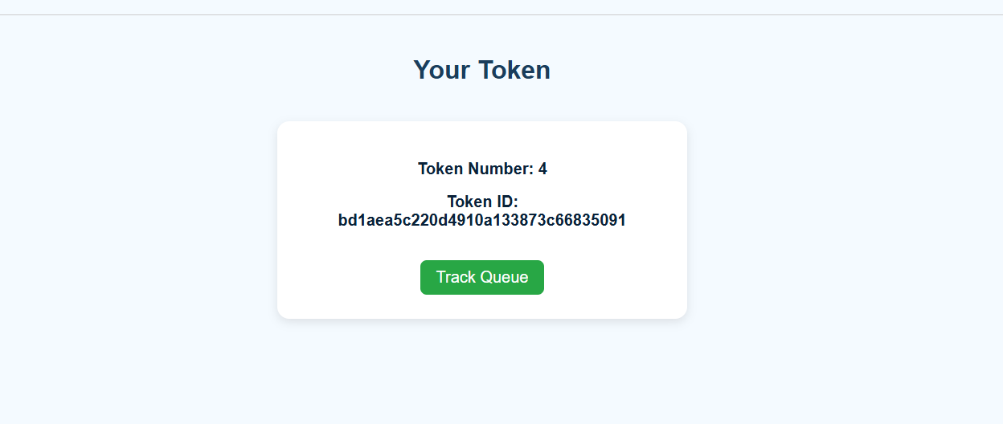
Results
Fig 9 : Token
Fig 8 : Digital Token booking

Slide 14
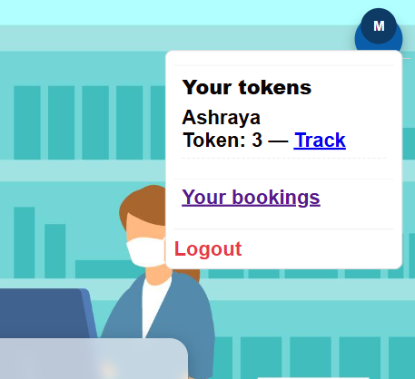
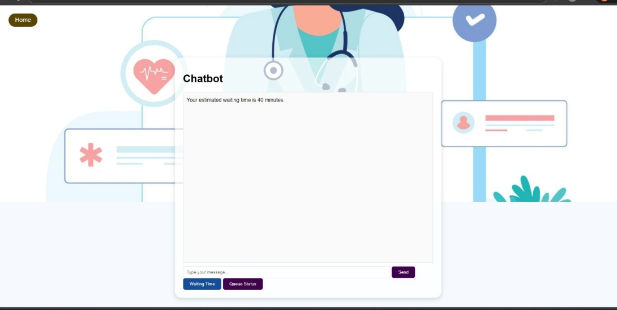
Results
Fig 10 : Token Tracking
Fig 11 : Queries with AI Bot

Slide 15
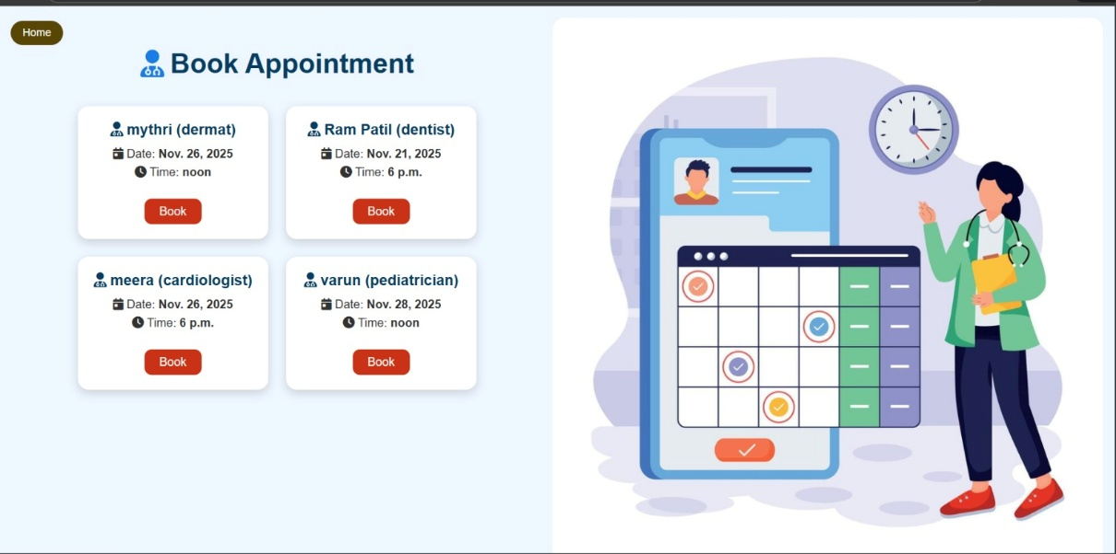
Results
Fig 12 : Scheduled Appointments

Slide 16
Conclusion
The system provides automation and transparency in hospital queue and bed management.
AI-powered interaction improves patient experience.
Online token booking reduces crowding and confusion.
The project helps hospitals transition toward digitized healthcare

Slide 17
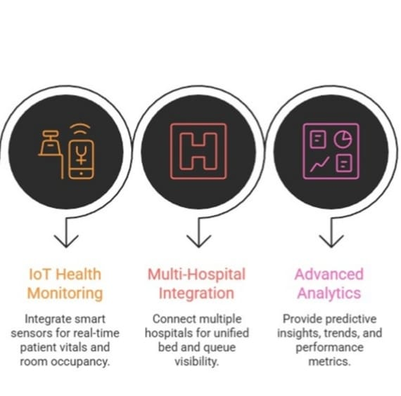
Future Work
Real-time location-based hospital suggestions.
IOT based monitoring.
Integration with government health databases.
Mobile app version for wider accessibility.
Multi-hospital dashboard for emergency services.
Fig 13: Future Work

Slide 18
GitHub Link
Ganesh H : https://github.com/Ganesh23
Manasa YK : https://github.com/ManasaYK17
Megha GK : https://github.com/Megha-GK
Nilesh Kumar Jha : https://github.com/Nilesh008

Slide 19
Thank you

